Slide 1
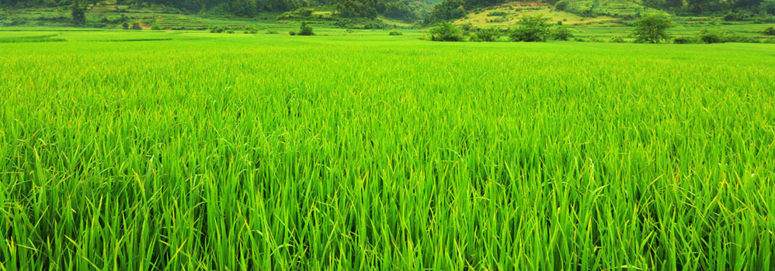
AGRICULTURE-A MINI PORTAL FOR OUR FAMERS
DESIGNED BY :
CHETHAN GC
RANJITH N GOWDA
PRATHITH TA

Slide 2

INTRODUCTION
1 .Our website is based on agriculture which is carried out by our farmers of our country,based on there reaserch and knowledge we will help the farmers.
2.The Website is the supporing hand as it contain the information and research work which will help them to implement it on agriculture and see it’s productivity and help the farmers by advisng them on crop development.
3. This website connects the entire world as it’s a forum where they can solve there problems from graduated students or the undergraduates who are in reserch feild.

Slide 3
THE IMPORTANT KEY ASPECTS FOR DESIGNING THE PROJECT
It’s a web portal created for training the farmers by Agriculture Department
“AS AGRICULTURE IS THE MOST HEALTHFUL ,MOST USEFUL AND MOST NOBLE EMPLOYMENT OF THE MANKIND “ It’s our duty to help the farmers
as they feed the world .
We have created website which is a agriculture hub which contains all the information for agriculturists to train the farmers
This website contain information on important aspects of organic farming agriculture, modern methods of farming , pesticide control ,GMO seeds . It’s a complete forum for agriculture.
We can post questions on the websites which are answered by the other agriculturists experts via phone call or mails .

Slide 4
7. Any scientific researches can be posted on the website by agricultre departmenrt.
This website will help the farmers to grow genetically modified crops, which helps to consider the challenges they face every day: crop loss from weeds, insects, and disease, and the effects of climate change such as drought with the help of gmo seeds
It will teach farmers on the pesticide control which is the most important area for a good productivity of the crops and the amount of pesticide we have to add which will not affect human health
“As farmers work on acres not on hours” we have mention some modern techniques which will fasten there process of productivity and
will create a barrier for disadvantages for traditional farming .
It will also tell the main points to be taken from organic farming which is most important for nutrition of crop
On these aspects we infer that our website has a rich material which will help the famers to feed generation

Slide 5
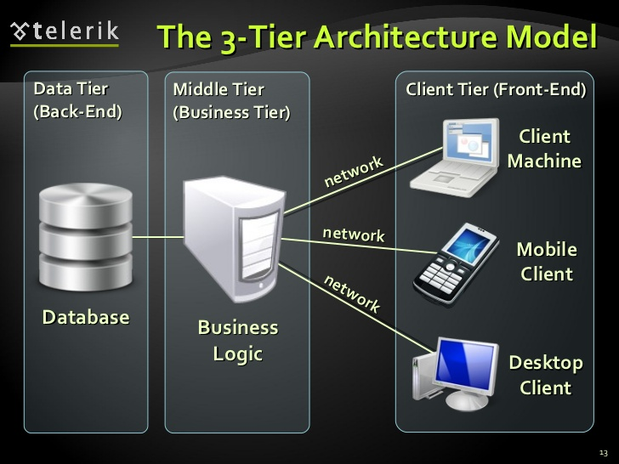
LIST OF TECHNOLOGIES USED :
THREE TIER ARCHITECHURE OF OUR WEBSITE
1) Client tier :
Designing: The website is designed by html which will align the text and
Styling is done by css and css 3 and interactions are done by java script
and validation is also done by java script which is the programming language of web
and also html 5 to add videos and more features
2) Web server tier: the web program is made to run on apache server and the language used is php
3) Database tier: the database used is my sql to store the informaton on the registration and login pages.

Slide 6
FUTURE ENANCEMENTS OF THE PROJECTS :
1) We want to make a feature so other agriculturists can upload the videos
2) We want statisticians to join hands want us so we can develop graphs on the
agriculture crop development based on the research work so we can predict the
usefulness of the research and implement in on the crops.
3) We would like to join hand with developers and create a mobile app
4) We can also tell the condition of farmers of different regions on the website so
that government can reach them through our website.
5)We can create a network between the farmer to farmer.
6)We can use AI to provide spot answers.
7)Updating the pages.
8)Creating two portals 1.Admin Portal(EXPERTS) 2.Client Portal(FARMERS)
and conveing the information to the farmers in better and understand able way.
9)As in India literacy level among farmers is to low so this leads to low understandability so for that purpose we have to create a translator that translate from one language to other.

Slide 7

BY THIS LET JOIN OUR HANDS WITH OUR FARMERS AND HELP THEM TO FEED US
THANK YOU!!!

